Slide 1
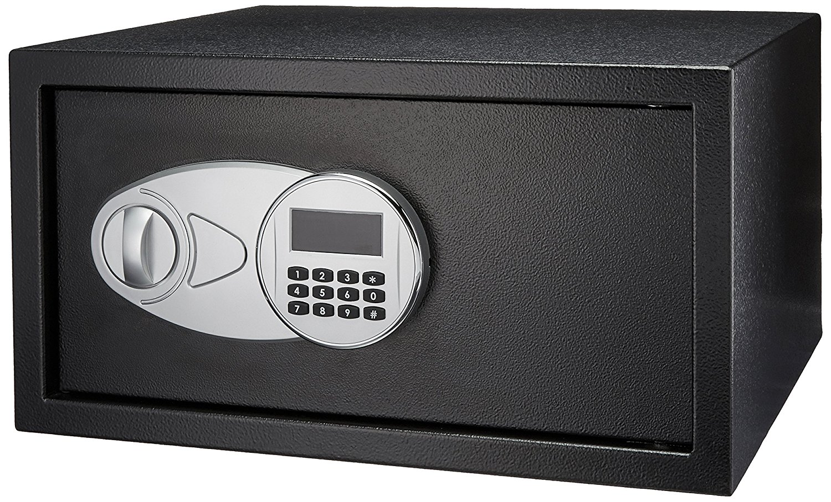
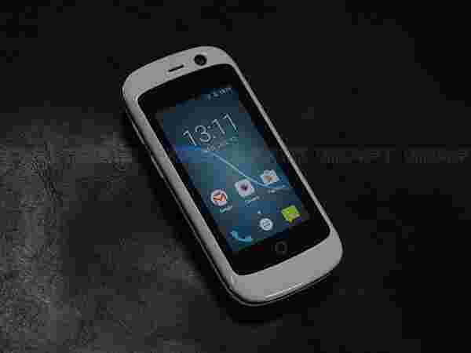
Smart box/safe application
Casey tran

Slide 2
Motivation
Sometimes I want to allow someone access to something while I am somewhere else across the globe but in a cost effective way.
Safes, let alone “smart” safes, can run up to $150
“Smart drawers” can be cute and a cost effective way to “deny access” until permitted.
Manufacturing price can be around $50 for prototype harware (rasberrypi 0 and a custom build or bought lockbox)

Slide 3


Proposal
To develop an Android-based smart phone application that allows for remote management of a drawer/box

Slide 4
App Features
Allow users to lock/unlock the box via wifi
Allow users to potentially sense if there’s anything in the box.
Allow users to slide a open an close a peep-hole opportunity for the box.
Allow multiple users to unlock/lock the bo

Slide 5
Phone Requirements
Android with internet connectivity
Iphone with internet connectivity

Slide 6
Project Timeline
March 12th – May 5th (About 2 months)

Slide 7
Anticipated Deliverables
March 21st the app is launched and connect to a network hosting the box.
March 28th the app is connected to the box’s hardware
April 4th The hardware is mounted and configured to the box’s lock
April 11th The box supports additional feautures such as the peep whole
April 18th – Aprl 30th Additional features.

